Slide 1
Topic : Number Theory

Slide 2
We have two numbers 2764 and 1369, find
i. LCM and GCD using Prime factorization
ii. GCD using Euclidean algorithm

Slide 3
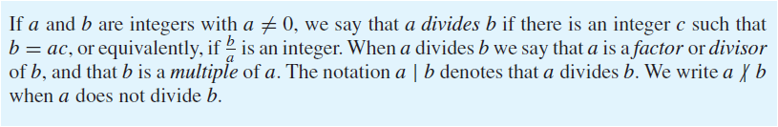
Introduction
We can express a | b using quantifiers as ∃c(ac = b), where the universe of discourse is the set of integers.

Slide 4
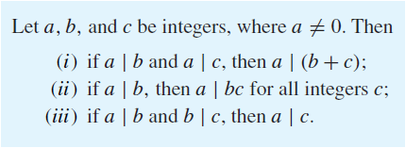
Example
Determine whether 3 | 7 and whether 3 | 12.
Theorem

Slide 5
Proof of Part (i)
Suppose that a | b and a | c. Then, from the definition of divisibility, it follows that there are integers s and t with b = as and c = at.
Hence, b + c = as + at = a(s + t).
Therefore, a divides b + c.

Slide 6
The Division Algorithm
Let a be an integer and d a positive integer. Then there are unique integers q and r, with 0 ≤ r < d, such that a = dq + r.
In the equality given in the division algorithm, d is called the divisor, a is called the dividend, q is called the quotient, and r is called the remainder. This notation is used to express the quotient and remainder:
q = a div d, r = a mod d.

Slide 7
Example
What are the quotient and remainder when 101 is divided by 11?
Solution
We have 101 = 11 ・ 9 + 2. Hence, the quotient when 101 is divided by 11 is 9 = 101 div 11, and the remainder is 2 = 101 mod 11.
Example
What are the quotient and remainder when −11 is divided by 3?
Solution
We have , −11 = 3(−4) + 1.
Hence, the quotient when −11 is divided by 3 is −4 = −11 div 3, and the remainder is 1 = −11 mod 3.

Slide 8
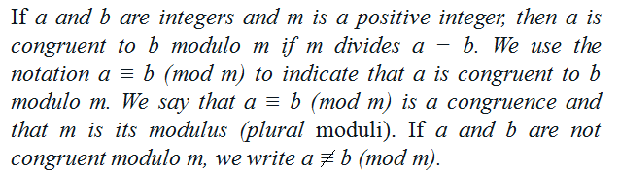
Modular Arithmetic

Slide 9
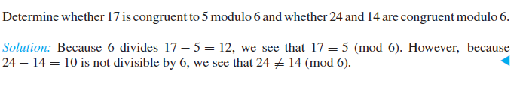
Theorem
Let a and b be integers, and let m be a positive integer. Then a ≡ b (mod m) if and only if a mod m = b mod m.
Recall that a mod m and b mod m are the remainders when a and b are divided by m, respectively. Consequently, this theorem says that a ≡ b (mod m) if and only if a and b have the same remainder when divided by m.
Example

Slide 10
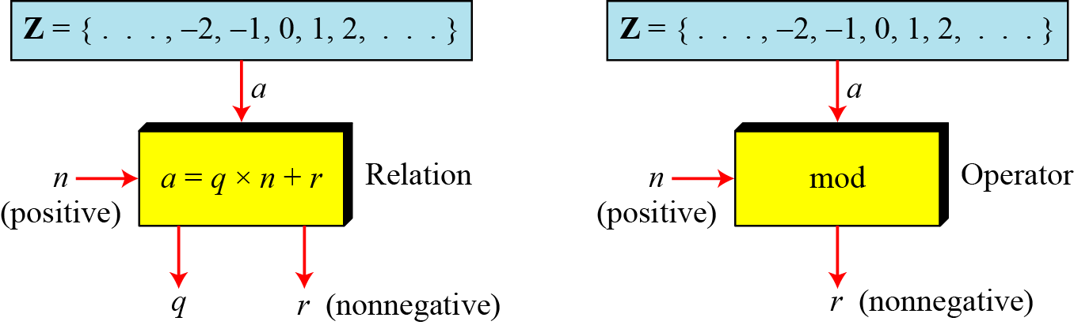
Modulo Operator
The modulo operator is shown as mod. The second input (n) is called the modulus. The output r is called the residue.
Figure Division algorithm and modulo operator
2.<number>

Slide 11
Continued
Example
Find the result of the following operations:
a. 27 mod 5 b. 36 mod 12
c. −18 mod 14 d. −7 mod 10
Solution
Dividing 27 by 5 results in r = 2
Dividing 36 by 12 results in r = 0.
c. Dividing −18 by 14 results in r = −4. After adding the modulus r = 10
d. Dividing −7 by 10 results in r = −7. After adding the modulus to −7, r = 3.
2.<number>

Slide 12
Theorem
Let m be a positive integer. The integers a and b are congruent modulo m if and only if there is an integer k such that a = b + km.
Proof
If a ≡ b (mod m), by the definition of congruence , we know that m | (a − b).
This means that there is an integer k such that a − b = km, so that a = b + km.
Conversely, if there is an integer k such that a = b + km, then km = a − b.
Hence, m divides a − b, so that a ≡ b (mod m).

Slide 13
Theorem
Let m be a positive integer. If a ≡ b (mod m) and c ≡ d (mod m), then a + c ≡ b + d (mod m) and ac ≡ bd (mod m).
proof
Because a ≡ b (mod m) and c ≡ d (mod m), then there
are integers s and t with a = b + sm and c = d + tm.
Hence,
a + c = (b + sm) + (d + tm) = (b + d) + m(s + t)
And
ac = (b + sm)(d + tm) = bd + m(bt + ds + stm).
Hence,
a + c ≡ b + d (mod m) and ac ≡ bd (mod m).

Slide 14
Example
Because 7 ≡ 2 (mod 5) and 11 ≡ 1 (mod 5),
18 = 7 + 11 ≡ 3 (mod 5)
and that
77 = 7 ・ 11 ≡ 2 (mod 5).

Slide 15
Arithmetic Modulo m
We can define arithmetic operations on Z_{m}, the set of nonnegative integers less than m, that is, the set {0, 1, . . . , m − 1}.
In particular, we define addition of these integers, denoted by +_{m} by a +_{m} b = (a + b) mod m, where the addition on the right-hand side of this equation is the ordinary addition of integers,
We define multiplication of these integers, denoted by ・_{m} by
a ・_{m} b = (a ・ b) mod m, where the multiplication on the right-hand side of this equation is the ordinary multiplication of integers.
The operations +_{m} and ・_{m} are called addition and multiplication modulo m and when we use these operations, we are said to be doing arithmetic modulo m.

Slide 16
Example
Use the definition of addition and multiplication in Z_{m} to find 7 +₁₁ 9 and 7 ・₁₁ 9.
Solution
Using the definition of addition modulo 11, we find that
7 +₁₁ 9 = (7 + 9) mod 11 = 16 mod 11 = 5,
and
7 ・₁₁ 9 = (7 ・ 9) mod 11 = 63 mod 11 = 8.
Hence 7 +₁₁ 9 = 5 and 7 ・₁₁ 9 = 8.

Slide 17
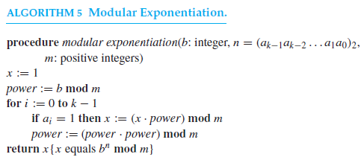
Modular Exponential
In cryptography it is important to be able to find b^{n} mod m efficiently, where b, n, and m are large integers.
It is impractical to first compute b^{n} and then find its remainder when divided by m because b^{n} will be a huge number. Instead, we can use an algorithm that employs the binary expansion of the exponent n.

Slide 18
Modular Exponential-Example
Use Algorithm 5 to find 3⁶⁴⁴ mod 645.
Algorithm initially sets x = 1 and power = 3 mod 645 = 3.
The binary expansion of 644, is (1010000100)₂

Slide 19
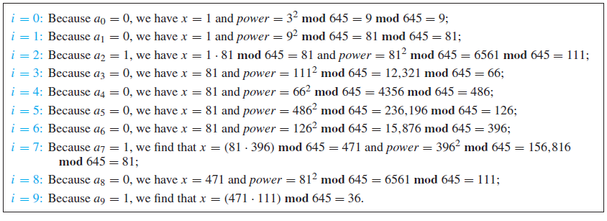
Continue

Slide 20
Primes
Every integer greater than 1 is divisible by at least two integers, because a positive integer is divisible by 1 and by itself. Positive integers that have exactly two different positive integer factors are called primes.
Definition
An integer p greater than 1 is called prime if the only positive factors of p are 1 and p. A positive integer that is greater than 1 and is not prime is called composite.
Example
The integer 7 is prime because its only positive factors are 1 and 7, whereas the integer 9 is composite because it is divisible by 3.

Slide 21
The Fundamental Theorem of Arithmetic
Every integer greater than 1 can be written uniquely as a prime or as the product of two or more primes where the prime factors are written in order of nondecreasing size.
Example
The prime factorizations of 100, 641, 999, and 1024 are given by
100 = 2 ・ 2 ・ 5 ・ 5 = 2²5²,
641 = 641,
999 = 3 ・ 3 ・ 3 ・ 37 = 3³ ・ 37,
1024 = 2 ・ 2 ・ 2 ・ 2 ・ 2 ・ 2 ・ 2 ・ 2 ・ 2 ・ 2 = 2¹⁰.

Slide 22

Theorem
If n is a composite integer, then n has a prime divisor less than or equal to .
Trial Division
From the above theorem , it follows that an integer is prime if it is not divisible by any prime less than or equal to its square root.
This leads to the brute-force algorithm known as trial division. To use trial division we divide n by all primes not exceeding and conclude that n is prime if it is not divisible by any of these primes.

Slide 23

Example
Show that 101 is prime.
Solution
The only primes not exceeding are 2, 3, 5, and 7. Because 101 is not divisible by 2, 3, 5, it follows that 101 is prime.

Slide 24
Procedure for finding prime factorization
Because every integer has a prime factorization, it would be useful to have a procedure for finding this prime factorization.
Consider the problem of finding the prime factorization of n. Begin by dividing n by successive primes, starting with the smallest prime, 2. If n has a prime factor, then a prime factor p not exceeding √ n will be found. So, if no prime factor not exceeding √ n is found, then n is prime. Otherwise, if a prime factor p is found, continue by factoring n/p. Note that n/p has no prime factors less than p. Again, if n/p has no prime factor greater than or equal to p and not exceeding its square root, then it is prime. Otherwise, if it has a prime factor q, continue by factoring n/(pq). This procedure is continued until the factorization has been reduced to a prime.

Slide 25
Example
Find the prime factorization of 7007.
Solution
To find the prime factorization of 7007, first perform divisions of 7007 by successive primes, beginning with 2. None of the primes 2, 3, and 5 divides 7007. However, 7 divides 7007, with 7007/7 = 1001.
Next, divide 1001 by successive primes, beginning with 7. It is immediately seen that 7 also divides 1001, because 1001/7 = 143.
Continue by dividing 143 by successive primes, beginning with 7. Although 7 does not divide 143, 11 does divide 143, and 143/11 = 13.
Because 13 is prime, the procedure is completed. It follows that 7007 = 7 ・ 1001 = 7 ・ 7 ・ 143 = 7 ・ 7 ・ 11 ・ 13. Consequently, the prime factorization of 7007 is 7 ・ 7 ・ 11 ・ 13 = 72 ・ 11 ・ 13.

Slide 26
The Sieve of Eratosthenes
Note that composite integers not exceeding 100 must have a prime factor not exceeding 10.
Because the only primes less than 10 are 2, 3, 5, and 7, the primes not exceeding 100 are these four primes and those positive integers greater than 1 and not exceeding 100 that are divisible by none of 2, 3, 5, or 7.
The sieve of Eratosthenes is used to find all primes not exceeding a specified positive integer. For instance, the following procedure is used to find the primes not exceeding 100.We begin with the list of all integers between 1 and 100.

Slide 27
The Sieve of Eratosthenes-Continue
To begin the sieving process, the integers that are divisible by 2, other than 2, are deleted.
Because 3 is the first integer greater than 2 that is left, all those integers divisible by 3, other than 3, are deleted.
Because 5 is the next integer left after 3, those integers divisible by 5, other than 5, are deleted.
The next integer left is 7, so those integers divisible by 7, other than 7, are deleted. Because all composite integers not exceeding 100 are divisible by 2, 3, 5, or 7, all remaining integers except 1 are prime.

Slide 28
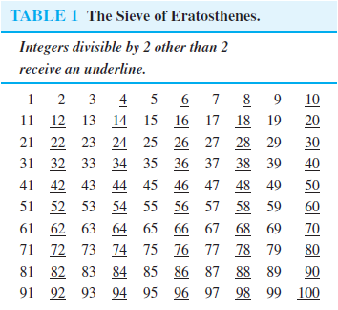
Example

Slide 29
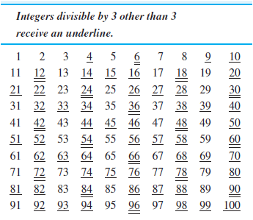
Continue

Slide 30
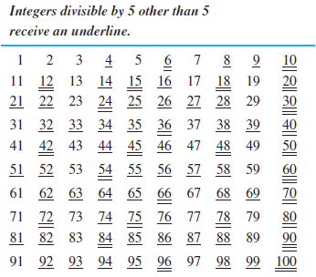
Continue

Slide 31
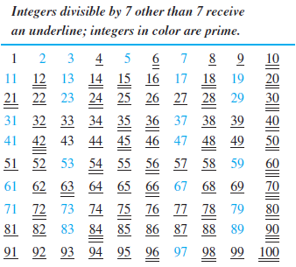
Continue
We conclude that the primes less than 100 are 2, 3, 5, 7, 11, 13, 17, 19, 23, 29, 31, 37, 41, 43, 47, 53, 59, 61, 67, 71, 73, 79, 83, 89, and 97.

Slide 32
Greatest Common Divisors and Least Common Multiples
The largest integer that divides both of two integers is called the greatest common divisor of these integers.
Let a and b be integers, not both zero. The largest integer d such that d | a and d | b is called the greatest common divisor of a and b. The greatest common divisor of a and b is denoted by gcd(a, b).
Example
What is the greatest common divisor of 24 and 36?
Solution
The positive common divisors of 24 and 36 are 1, 2, 3, 4, 6, and 12. Hence, gcd(24, 36) = 12.

Slide 33
Example
What is the greatest common divisor of 17 and 22?
Solution
The integers 17 and 22 have no positive common divisors other than 1, so that gcd(17, 22) = 1.
Definition
The integers a and b are relatively prime if their greatest common divisor is 1.
Example
Integers 17 and 22 are relatively prime, because gcd(17, 22) = 1.

Slide 34
Definition
The integers a₁, a₂, . . . , a_{n} are pairwise relatively prime if gcd(a_{i}, a_{j} ) = 1 whenever 1 ≤ i < j ≤ n.
Example
Determine whether the integers 10, 17, and 21 are pairwise relatively prime and whether the integers 10, 19, and 24 are pairwise relatively prime.
Solution
Because gcd(10, 17) = 1, gcd(10, 21) = 1, and gcd(17, 21) = 1, we conclude that 10, 17, and 21 are pairwise relatively prime.
Because gcd(10, 24) = 2 > 1, we see that 10, 19, and 24 are not pairwise relatively prime.

Slide 35


Finding gcd using prime factorization
Suppose that the prime factorizations of the positive integers a and b are
where each exponent is a nonnegative integer, and where all primes occurring in the prime factorization of either a or b are included in both factorizations, with zero exponents if necessary.
Then gcd(a, b) is given by

Slide 36
Example
Because the prime factorizations of 120 and 500 are 120 = 2³ ・ 3 ・ 5 and 500 = 2² ・ 5³, the greatest common divisor is
gcd(120, 500) = 2 ^{min(3, 2)} 3 ^{min(1, 0)} 5 ^{min(1, 3)} = 2²3⁰5¹ = 20.
Least Common Multiple
The least common multiple of the positive integers a and b is the smallest positive integer that is divisible by both a and b. The least common multiple of a and b is denoted by lcm(a, b).

Slide 37

Least Common Multiple-Continue
Prime factorizations can also be used to find the least common multiple of two integers.
Suppose that the prime factorizations of a and b are as before. Then the least common multiple of a and b is given by
where max(x, y) denotes the maximum of the two numbers x and y.
Example
Solution

Slide 38
The Euclidean Algorithm
Computing the greatest common divisor of two integers directly from the prime factorizations of these integers is inefficient. The reason is that it is time-consuming to find prime factorizations.
A more efficient method of finding the greatest common divisor, is called the Euclidean algorithm.
This algorithm has been known since ancient times. It is named after the ancient Greek mathematician Euclid, who included a description of this algorithm in his book The Elements.
Lemma
Let a = bq + r, where a, b, q, and r are integers. Then gcd(a, b) = gcd(b, r).

Slide 39

Continued
Note
Greatest Common Divisor
The greatest common divisor of two positive integers is the largest integer that can divide both integers.
Note
Euclidean Algorithm
Fact 1: gcd (a, 0) = a
Fact 2: gcd (a, b) = gcd (b, r), where r is
the remainder of dividing a by b
2.<number>

Slide 40
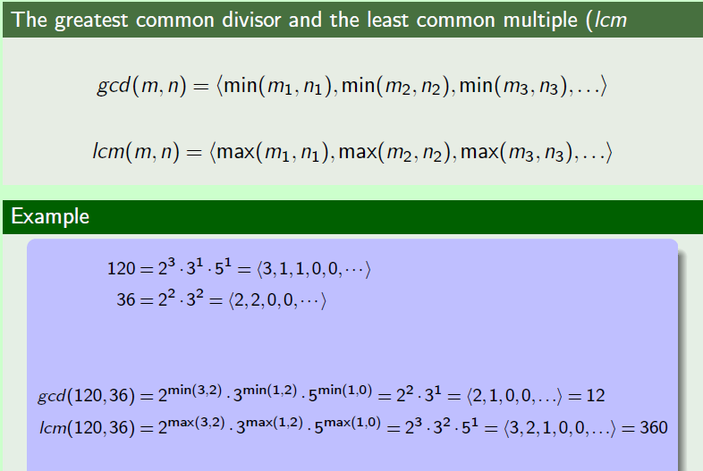

Slide 41
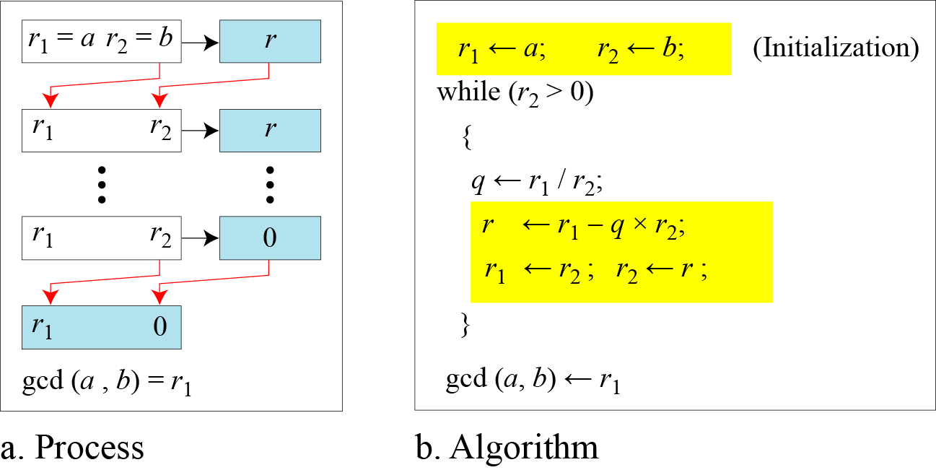
Continued
Figure Euclidean Algorithm
Note
When gcd (a, b) = 1, we say that a and b are relatively prime.
2.<number>

Slide 42

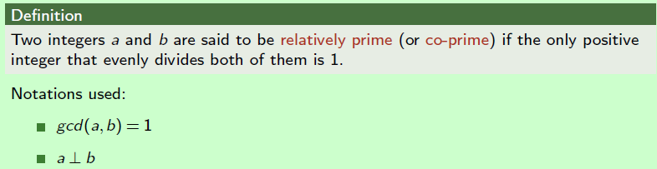
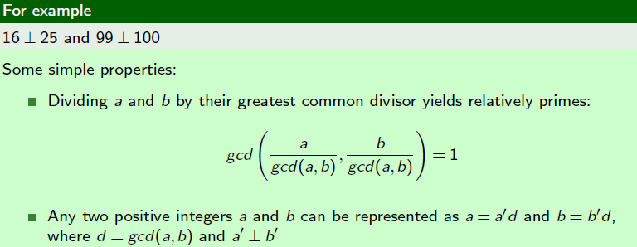

Slide 43
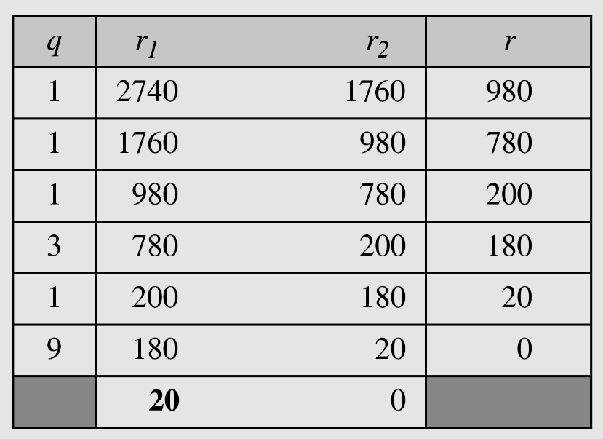
Continued
Example
Find the greatest common divisor of 2740 and 1760.
Solution
We have gcd (2740, 1760) = 20.
2.<number>

Slide 44
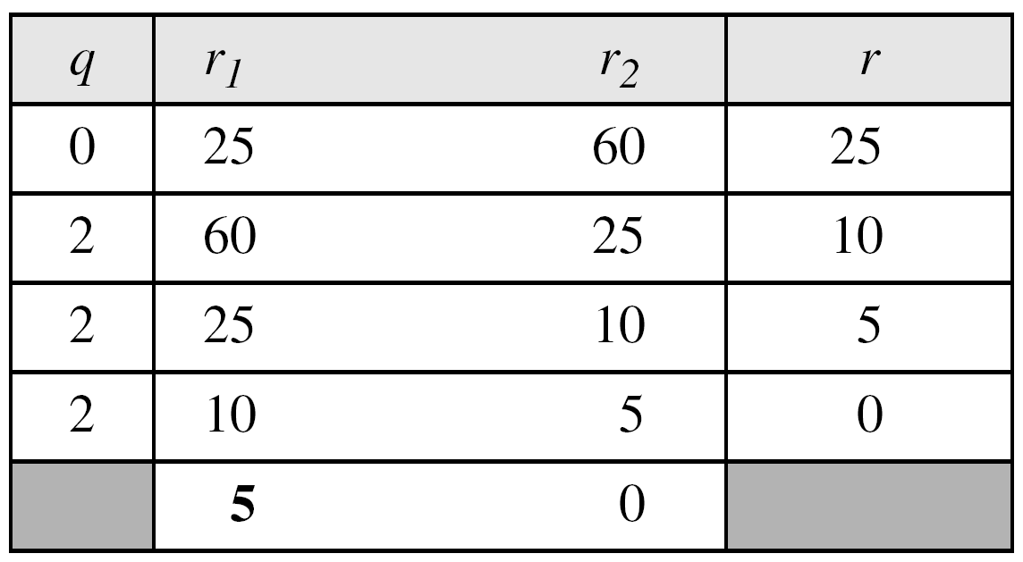
Continued
Example
Find the greatest common divisor of 25 and 60.
Solution
We have gcd (25, 65) = 5.
2.<number>

Slide 45
Explaining Euclidean Algorithm
Find gcd(91, 287).
First, divide 287, the larger of the two integers, by 91, the smaller, to obtain
287 = 91 ・ 3 + 14.
Hence, the greatest common divisor of 91 and 287 is the same as the greatest common divisor of 91 and 14. This means that the problem of finding gcd(91, 287) has been reduced to the problem of finding gcd(91, 14).
Next, divide 91 by 14 to obtain
91 = 14 ・ 6 + 7.
it follows that gcd(91, 14) = gcd(14, 7).

Slide 46
Continue
Continue by dividing 14 by 7, to obtain
14 = 7 ・ 2.
Because 7 divides 14, it follows that gcd(14, 7) = 7.
Furthermore, because gcd(287, 91) = gcd(91, 14) = gcd(14, 7) = 7, the original problem has been solved.
Hence, the greatest common divisor is the last nonzero remainder in the sequence of divisions.

Slide 47
Example
Find the greatest common divisor of 414 and 662 using the Euclidean algorithm.
Solution
Successive uses of the division algorithm give:
662 = 414 ・ 1 + 248
414 = 248 ・ 1 + 166
248 = 166 ・ 1 + 82
166 = 82 ・ 2 + 2
82 = 2 ・ 41.
Hence, gcd(414, 662) = 2, because 2 is the last nonzero remainder.

Slide 48
End

